Slide 1
WageWorks
Health Savings Accounts &
The Employee Experience

Slide 2
What is a Health Savings Account (HSA)?
Pre-tax benefit account that works a lot like a 403(b)
Set aside pre-tax money to pay for everyday health expenses
HSAs are designed to help individuals save for future qualified medical and retiree health expenses on a tax-free basis
To qualify for an HSA, the individual must have a High Deductible Health Care Plan (HDHP)
An HSA in combination with an HDHP aims to empower health care consumers with control, choice, and information

Slide 3
Who is eligible for an HSA?
Individuals who are covered by an HSA-compatible health plan are qualified if they are:
Not covered by any other non HSA-compatible health insurance plan
Not claimed as a dependent on another person’s tax return (excluding spouse’s)
Not enrolled in Medicare
Do not receive health benefits under TRICARE
Have not received Veterans Administration (VA) benefits within the past three months
Not covered by a general purpose health care flexible spending account (FSA) or health reimbursement account (HRA), including a spouse’s

Slide 4
The HSA Advantage
All funds roll over from year to year
No “use it or lose it” rules
Tax benefits on contributions, earnings and distributions
Contributions are either pre-tax (via paycheck) or tax-deductible
Portability
Funds follow you, may be transferred to other banks
Tax-free withdrawals for Qualified Medical Expenses even if qualifying coverage ends
Long-term investment opportunities (Not FDIC insured)

Slide 5
Withdrawals & Reimbursements
Withdrawals for qualified medical, dental, or vision expenses are tax-free
Withdrawals not used for qualified expenses are assessed a tax penalty, plus normal income tax
No penalty to withdraw if 65 or older, or on certain types of disability
Income tax still applies if not for qualified expenses

Slide 6
Eligible Expenses
Use Your HSA to pay for:
Prescriptions for almost any medical condition
Prescribed over-the-counter medicines, e.g. aspirin, cough syrup
Co-payments, co-insurance, and deductibles
Dental care, both preventive and restorative
Orthodontia, child and adult
Vision care, eyeglasses, contact lenses, solutions
Eye surgery, including laser vision correction
Counseling and therapy
Psychology and psychiatry
Chiropractic care and acupuncture
See www.wageworks.com/myhsa for more information

Slide 7
Spouse and Dependent Expenses
Spouse and dependent expense eligibility is determined by tax-filing standards
If filing jointly or claiming as a dependent on your taxes, their expenses can be reimbursed from HSA
Spouse/dependent does NOT have to be covered by your HDHP to qualify for HSA reimbursement

Slide 8
Limited Purpose FSA
Enrollment for both HC FSA and HSA are allowed, but the FSA must be Limited (or “HSA-Compatible”)
Limited Purpose HC FSA covers only Dental and Vision expenses
Limited FSA may be converted to a full purpose FSA after the HDHP deductible has been met for the year

Slide 9
FSA, HSA, or Both?
 | FSA | HSA
Accompanying Health Plan | Any | High Deductible Health Plan
Maximum Election | $2700 | $3550– Single coverage $7100 – Family coverage +$1000 – “Catch up” for 55+
Funds Available | January 1st | As taken from paychecks
End of Year Balance | Carryover up to $500 | 100% rollover, unlimited ongoing balance
Tied to Employment? | Yes | No, portable
Mutual Fund Investments? | No | Yes
Use Funds via Card? | Yes | Yes
Eligible Expenses | Medical, Dental, Vision (Limited FSA covers only dental & vision until HDHP deductible is met) | Medical, Dental, Vision

Slide 10
Why Enroll?
Tax savings
Wide range of covered expenses
Easy access to account details
Range of payment options
Long-term investment options
Portability

Slide 11
BNY Mellon - Investment Options
Leading wealth management platform
Top 5 HSA custodian
FDIC insured
Customizable investment options
25 no-load mutual funds to choose
$1,000 minimum to invest
Automatic allocations
Single sign-on with WageWorks
Makes managing your account easy

Slide 12
Statements & Tax Forms
Statements – Quarterly
$0.75 fee, deducted from HSA balance each quarter if you select Paper statements
W2, Forms 1099 and 5498
Form 8889
You must complete this form and file with your 1040

Slide 13
Employee Separation
If you separate from the company…
Spending card and other functionality remains active for the HSA
Card will no longer access FSA account (if applicable)
WageWorks will notify you in writing of your options:
Keep HSA open with WageWorks, liquidate and close the account, transfer funds to your other HSA

Slide 14
Completing the HSA Application

Slide 15
Registering Online
From the WageWorks.com homepage click Log In/Register -> Employee Registration

Slide 16
Registering Online
Review the User Agreement and Terms and Conditions, create username and password, confirm contact information, set up direct deposit

Slide 17
HSA Application
Click the “Finish Opening Your HSA” button to launch the HSA application

Slide 18
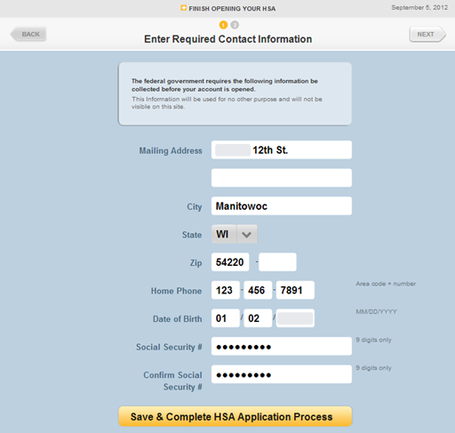
HSA Application
After clicking this button, remaining application steps are on BNY Mellon’s site.

Slide 19
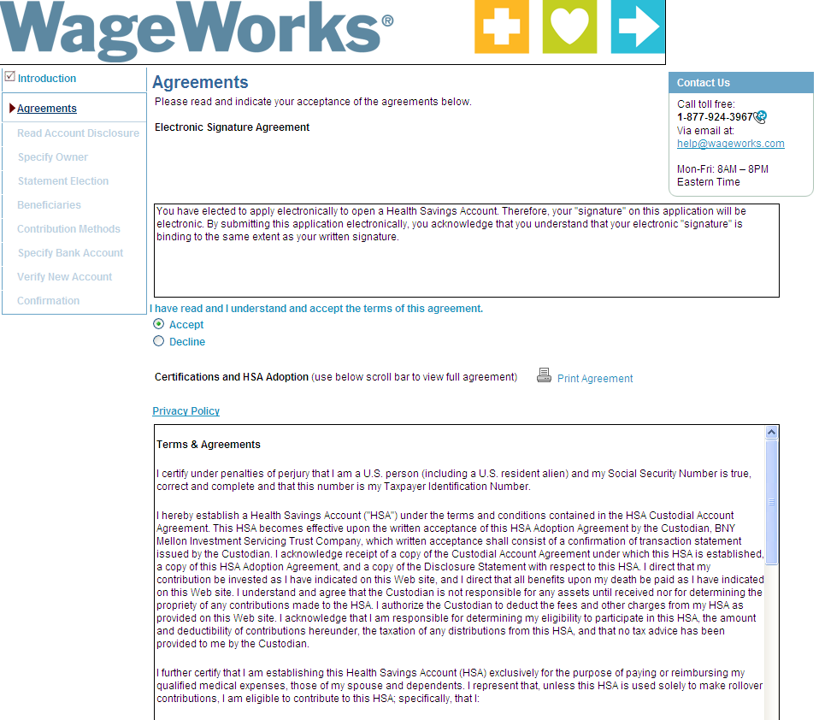
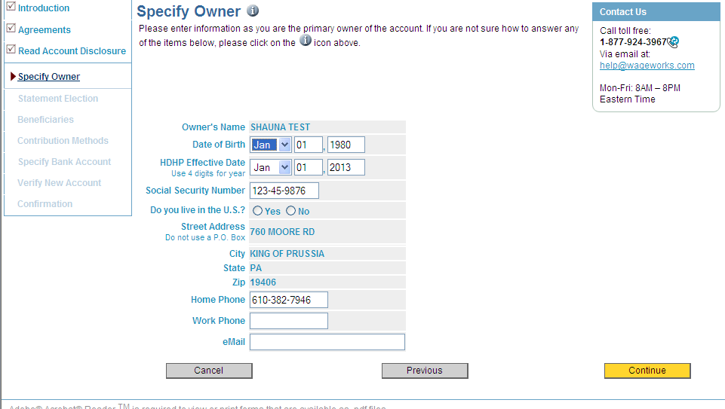
Instructions, General Info
Review terms & conditions, confirm identifying information

Slide 20
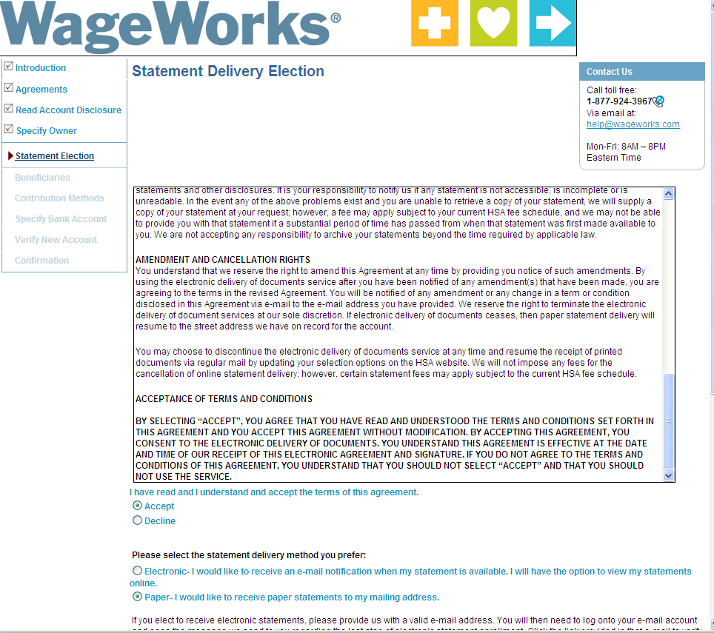
Select Paper or E-mail Statements
$ 0.75 deducted from HSA balance each quarter if you select Paper

Slide 21
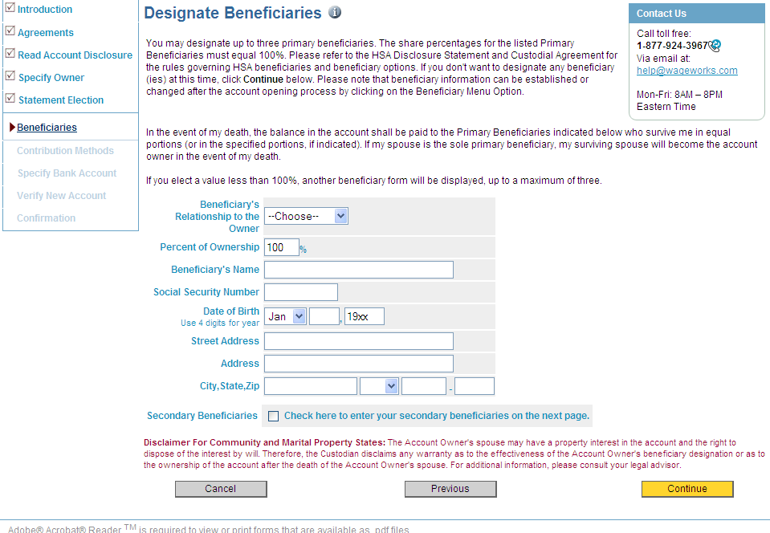
Add Beneficiaries
Beneficiaries can be added (or changed) later, as well

Slide 22
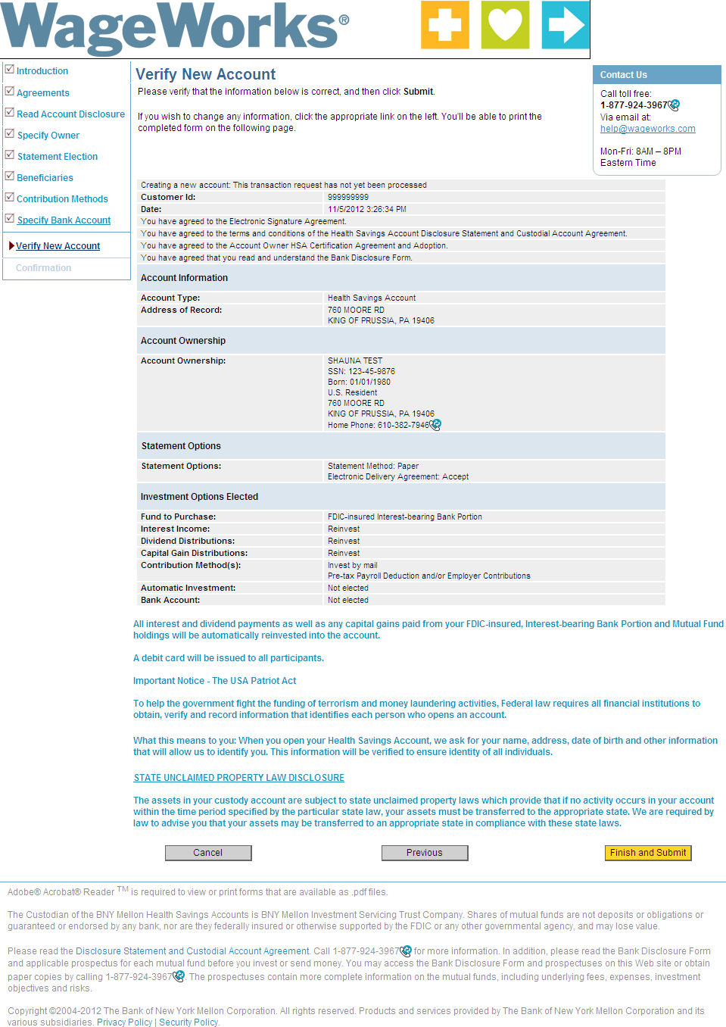
Confirm your information
Almost done… be sure to click Finish and Submit

Slide 23
Complete!
WageWorks HealthCare Card will issue once you have completed the application
If you also signed up for Limited FSA, the Card will issue even if you have yet to complete the HSA application
Be sure to complete the application before January 1st to ensure the account will be ready to accept your first payroll contribution

Slide 24
FSA & HSA Employee Experience

Slide 25
Payment Options
EZ Receipts app
 | File a claim and upload a picture of receipt | Supports iPhone and Android smart phones
Pay My Provider
 | Online bill payment for HC / DC expenses | Ideal for co-insurance, day care, ortho and dental
Pay By Card
 | Access both FSA and HSA funds with same Card | Use as Credit, but PIN can be requested
Pay Me Back
 | Mail, fax, online Check or Direct Deposit | 48-hour claims turn-around
Pay Me
 | HSA ONLY No receipt required | Send payment to your self

Slide 26
Card Substantiation
FSA
Per the IRS, all transactions must be substantiated.
Receipts will not be needed if a card transaction meets one of the following criteria:
Match to a Recurring Transaction
Health plan Co-Payment amount
Merchant has IRS-approved Inventory System
If receipt/EOB/etc. is not submitted in 90 days, Card will be suspended
HSA
No substantiation to WageWorks is required
IRS will impose an additional 20% tax on the part of the distributions not used for Qualified Medical Expenses

Slide 27
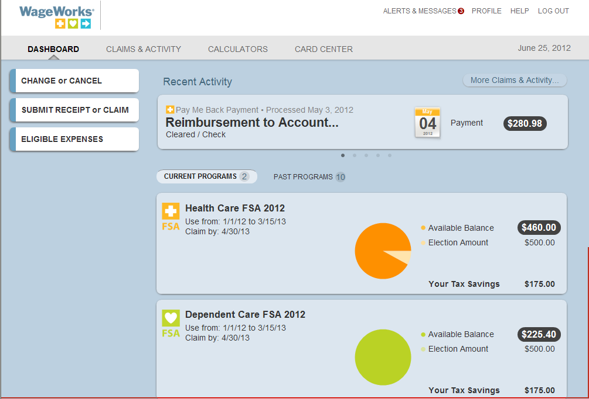
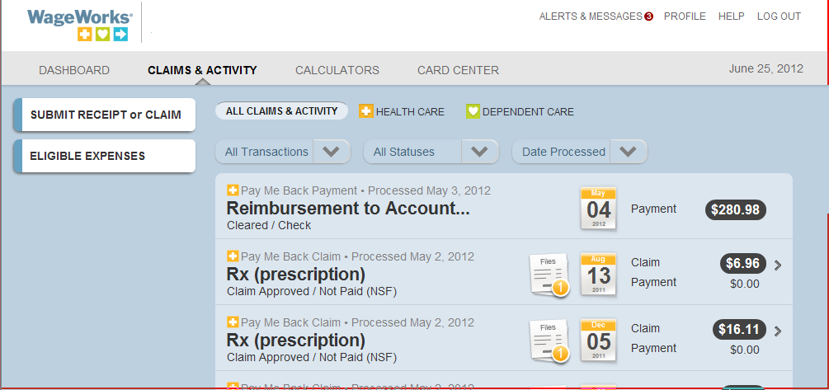
Employee Site
Online view of activity is available 24/7
One view for all plan types
Set options for email and text notifications

Slide 28
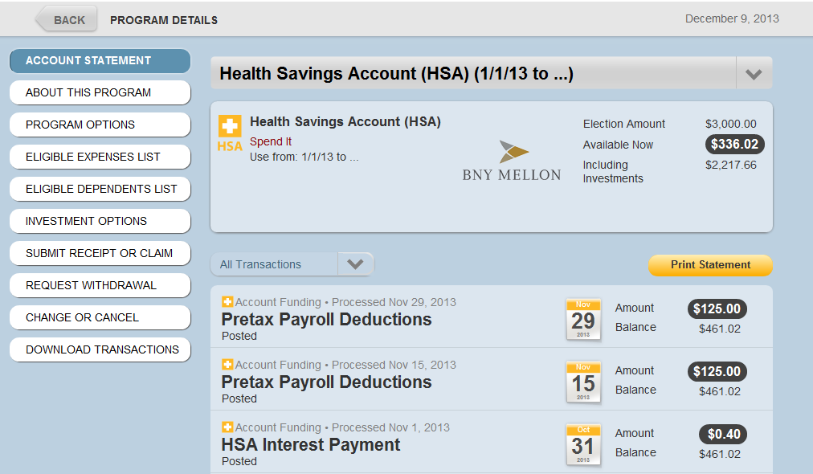
Accessing BNY Mellon
From your HSA Account Activity page, click “Investment Options” to access your BNY Mellon account

Slide 29
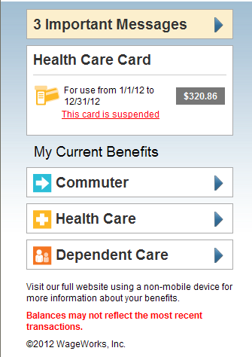
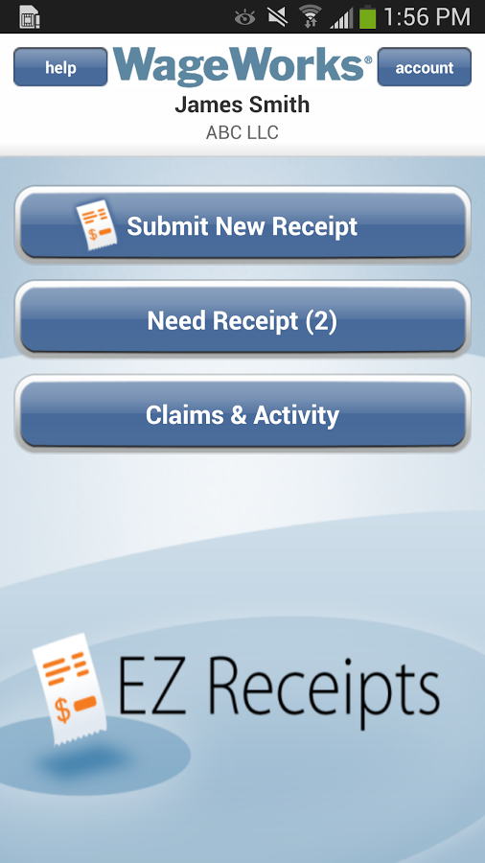
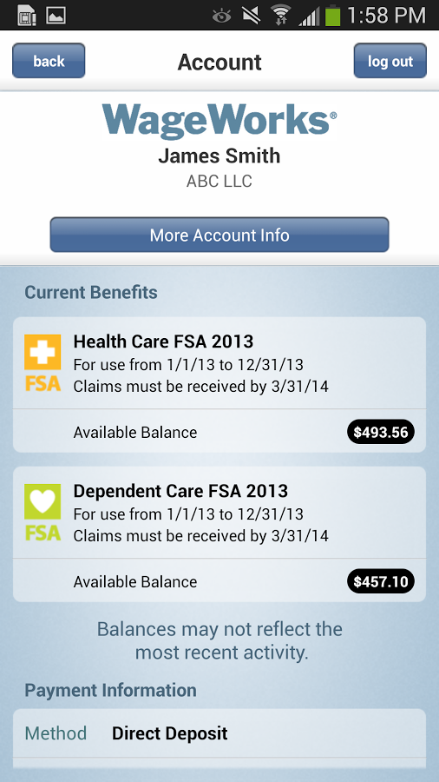
Mobile Account Access
Mobile Site
EZ Receipts App

Slide 30
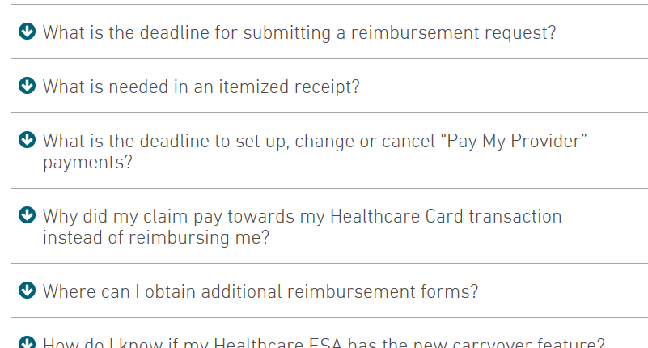
Online Resources
Visit WageWorks.com for plan information, eligible expenses, forms, and more

Slide 31
Customer Service
You may call for account information at 1-877-WAGEWORKS (877-924-3967)
Customer Service Representatives are available Monday thru Friday, 8 AM to 8 PM ET (excluding holidays)

Slide 32
Questions?

